Slide 1

This course was developed as a part of several VLIR-UOS projects:
Cross-cutting Statistics: 2011-2016, 2017.
Cross-cutting Statistics: 2017.
Statistics for development : 2018-2022.
The >rR-BioStat platform ITP project: 2024-2026.

Slide 2




Introduction to Statistical inference and estimation using R: Inference for numerical data (one population & two populations)
The >eR-Biostat initiative
Making R based education materials in statistics accessible for all
Developed by
Ziv Shkedy (Hasselt Univesrsity) and Tadesse Awoke (Gondar University)
LAST UPDATE: 03/2024
ER-BioStat
https://github.com/eR-Biostat
@erbiostat

Slide 3
Development team
Tadele Worku Mengesha (Gondar University).
Abdisa Gurmessa (Jmma University).
Ziv Shkedy (Hasselt Univesrsity).
Tadesse Awoke (Gondar University).

Slide 4

Recommended reading
We cover mainly Chapter 5.
The examples that are used for illustration are not the same as the examples in the book.
Chapter 5: Inference for numerical data

Slide 5
Software
R functions:
  t.test().

Slide 6
YouTube tutorials
YouTube tutorials are available for:
  Two-Sample t Test in R: Independent Groups (R Tutorial 4.2)(host: MarinStatsLectures-R Programming & Statistics): https://www.youtube.com/watch?v=RlhnNbPZC0A&t=70s.
  Statistics with R - Two sample t-test with R (t.test) (host: Dragonfly Statistics): https://www.youtube.com/watch?v=e5JJxBb80CQ.

Slide 7
Datasets
Data are given as a part of R programs for the course.
External datasets (which are not given as a part of the R code) and used for illustration are available online:

Slide 8
Topics
Inference for one sample mean with t-distribution.
One-sample t test.
Two-samples test:
  Independent samples.
  Paired samples.

Slide 9
Inference for one-sample mean with the t distribution
This part (slides 9 – slide 60) was covered also in the first slides set.
Section 5.1

Slide 10
5.1: Inference for one-sample means with the t distribution

Slide 11
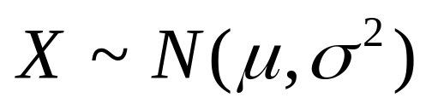
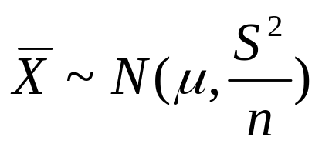
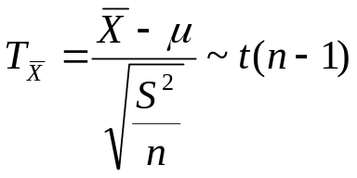
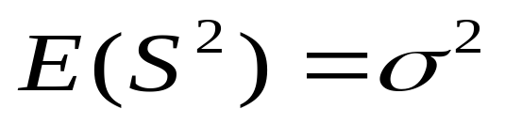
t-test for a population
We assume that X~N(μ,σ²) & n is small
For this test, we used the Student t distribution.
as
X has a normal distribution with unknown μ and σ². n is small
than:
and

Slide 12
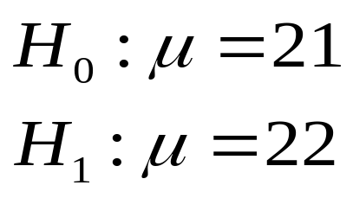
example
A researcher would like the following hypotheses :
We assume that

Slide 13
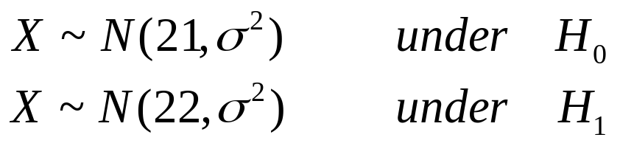
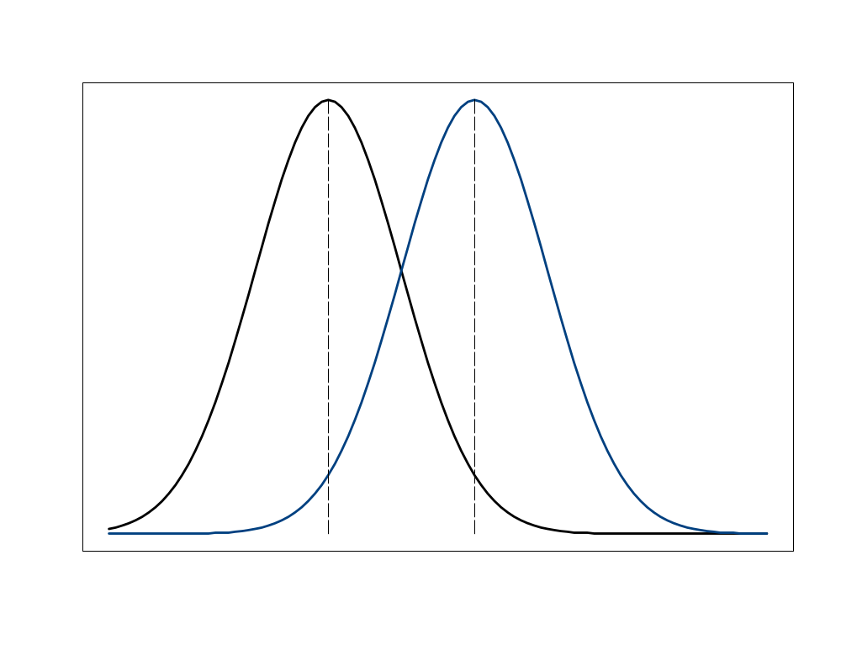
The distribution of the population
H₀
H₁
The distribution of population among H₁
The distribution of population among H₀
21
22

Slide 14
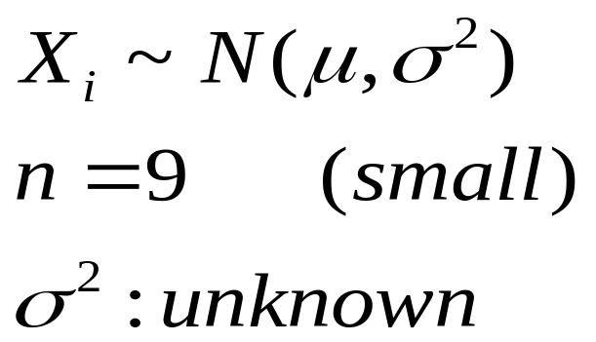
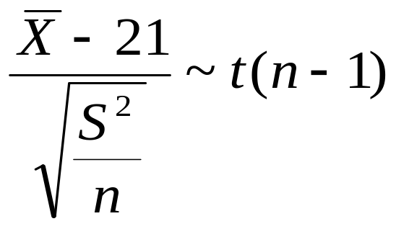
the sample
To test the hypotheses, we draw a sample of size 9 (n = 9) from the population.
X has a normal distribution with unknown μ and σ².
n is small
The distribution of the test statistic population under H₀

Slide 15

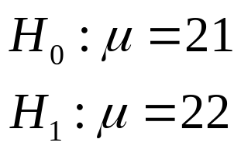
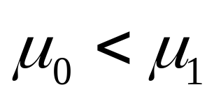
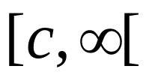
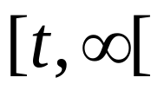
The rejection region
when the value of is greater than
c then we reject the null
hypothesis
rejection region
C
when the value of T is larger than
c then we reject the null
hypothesis
rejection region
t

Slide 16

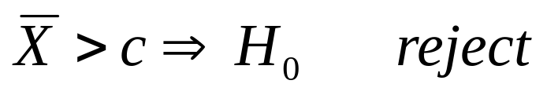
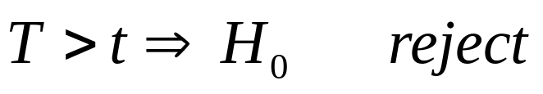
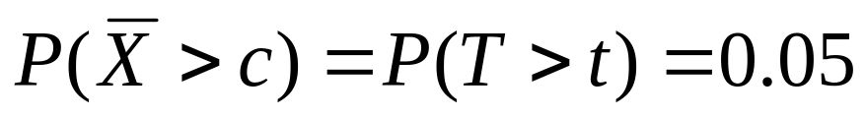
The choice of c
We choose c so that Type I error 0.05.
if the null hypothesis is correct

Slide 17
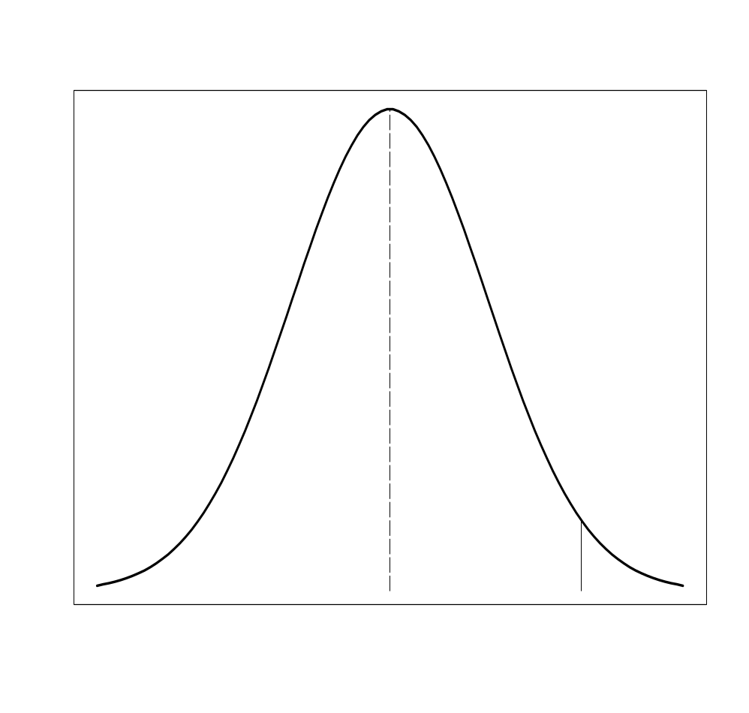

The critical point
t(8)
The distribution of the test statistic under H₀
0.05
0
t

Slide 18
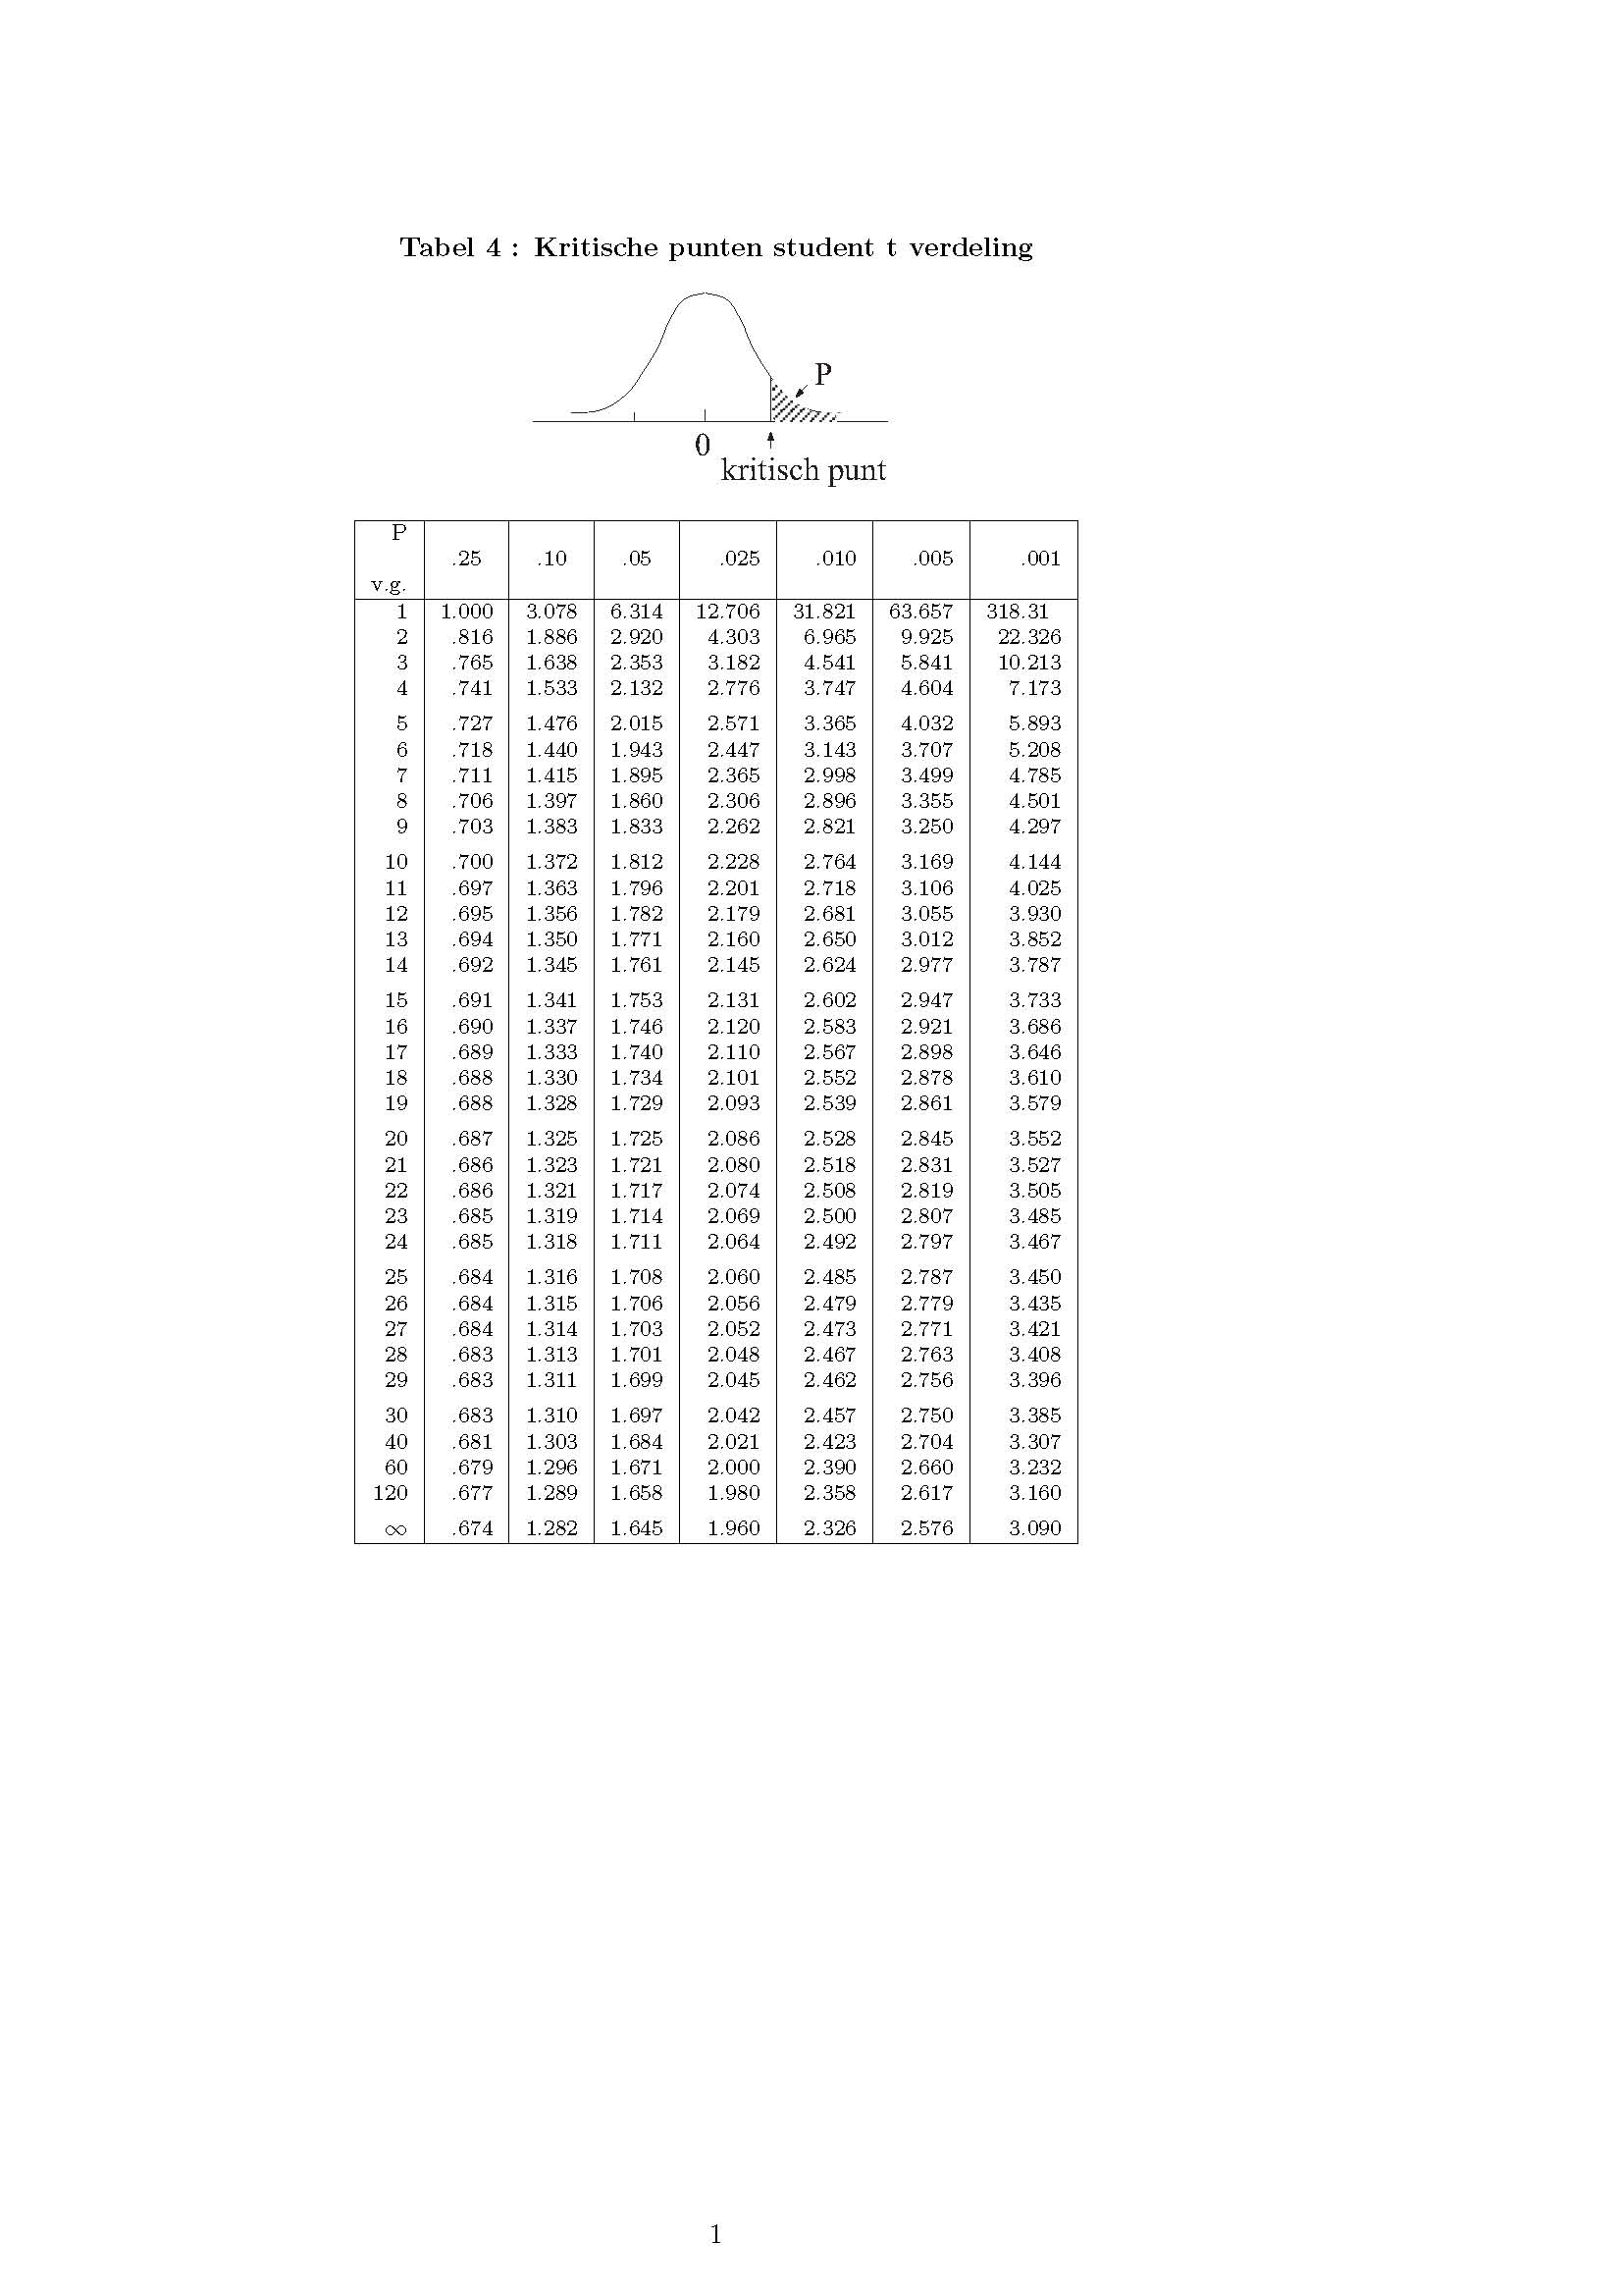
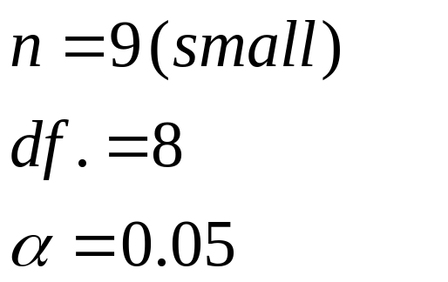


Student's t-distribution and critical point

Slide 19

Student's t-distribution and critical point in R
> df<-8
> alpha<-0.05
> crit.val<-qt(1-alpha,df)
> crit.val
[1] 1.859548
> pt(crit.val,df)
[1] 0.95
0.95

Slide 20
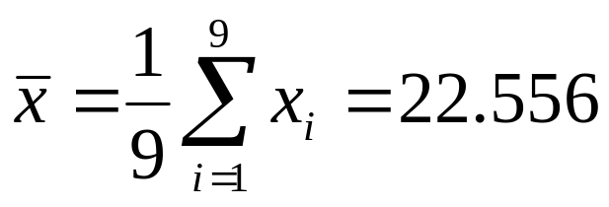
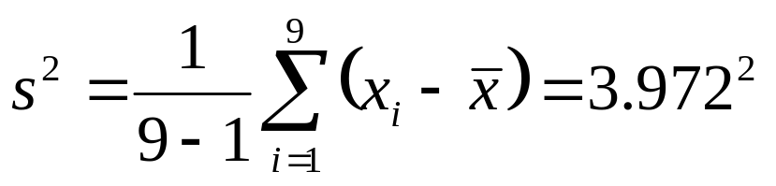
The sample
subject | X_{i}
1 | 22
2 | 19
3 | 17
4 | 26
5 | 21
6 | 20
7 | 29
8 | 27
9 | 22
n=9
The estimators for the unknown parameters (μ and σ ²) in the population

Slide 21
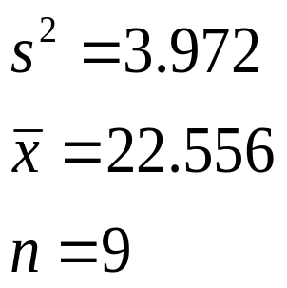
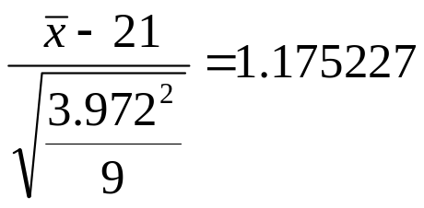
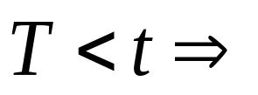
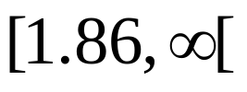

The rejection region & statistic
We do not reject H₀
rejection region
1.86…

Slide 22
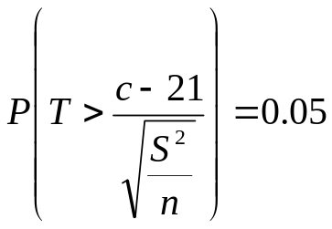

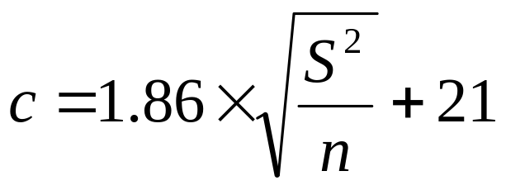
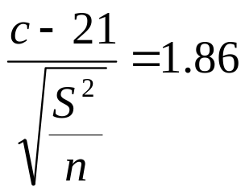

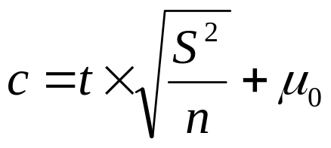
The rejection region
rejection region
c

Slide 23
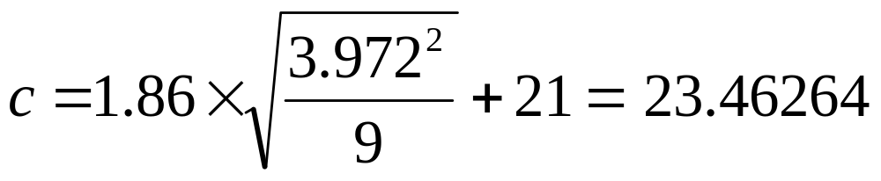
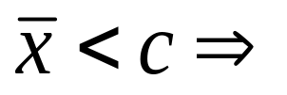
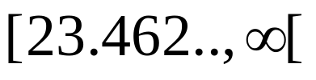

The rejection region
We do not reject H₀
rejection region
23.46…

Slide 24

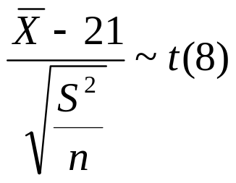
the checklist
Step | information | example
1 | The hypotheses (the qualifying problem)
2 | The distribution in the population and σ2
3 | sample size
4 | The distribution of the sample mean | Unknown
5 | The level of significance
6 | The test statistic
7 | The distribution of the test statistic
8 | The critical point (or points)
σ² not known
1.86 t(8)

Slide 25
R code
> x=c(22,19,17,26,21,20,29,27,22)
> xbar=mean(x)
> mu = 21
> s = sd(x)
> n = length(x)
> t = (xbar-mu)/(s/sqrt(n))
> t # test statistic
[1] 1.174854
> crit.val = qt(1-alpha, n-1, lower.tail = TRUE)
> crit.val # critical value
[1] 1.859548
The test statistic 1.174854 is greater than the critical value of 1.859548. Hence, at 0.05 significance level, we can reject the null hypothesis.

Slide 26
Example:
heights and weights for American women aged 30–39.
> womenheight=women$height
> t.test(womenheight,mu=60,conf.level=0.90)
One Sample t-test
data: womenheight
t = 4.3301, df = 14, p-value = 0.000692
alternative hypothesis: true mean is not equal to 60
90 percent confidence interval:
62.96621 67.03379
sample estimates:
mean of x
65

Slide 27
Testing a hypothesis about a Population parameter (2)
One sided and two-sided testing problems

Slide 28
The hypothesis and the alternative hypothesis
In the previous example, we tested the hypothesis that the mean of a normal distribution with unknown variance equal to a certain value (21).
As an alternative hypothesis we mean that it was equal to another specified
value (22).
In practice, the researcher usually do not know the exact details of the alternative hypothesis.

Slide 29
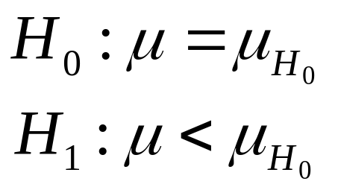
Case (a)
The average under H₁ is smaller than the average under H₀
null hypothesis
alternative hypothesis
One sided test problem

Slide 30
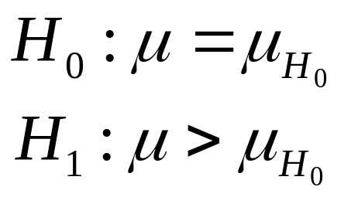
case (b)
The average under H₁ is greater than the average under H₀ :
null hypothesis
alternative hypothesis
One sided test problem

Slide 31
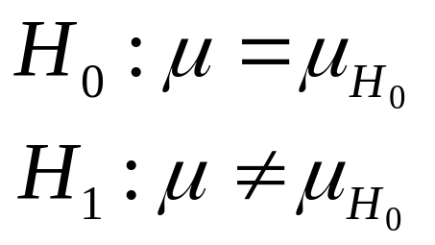
Case (c)
The average under H₀ is not equal to the mean under H₁ :
null hypothesis
alternative hypothesis
two sided test problem

Slide 32
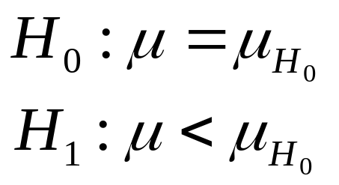
example (case a)
One sided test

Slide 33
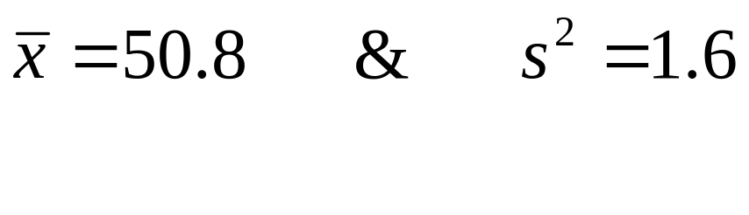
Example: one-tailed test
A gynecologist says that girls at birth, averaging less than 51 cm.
His colleague Judge reproach him that his claim is based on a prejudice, and that the average length is 51 cm indeed.
They draw a sample of 100 girls.
In the sample:

Slide 34
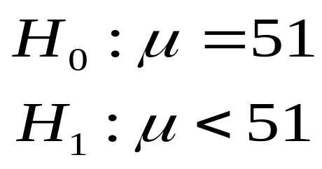
The testing problem
The choice of H₁ reflects here the assertion of the first gynecologist
null hypothesis
alternative hypothesis
One-sided test

Slide 35
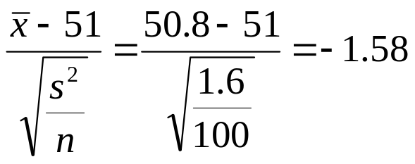

The test statistic
We now supplement the sample values ​​and find:
Conclusion: at significance level of 5%, the length of girls at birth 51 cm.
-1.645
-1.58
rejection region
to rejection region

Slide 36
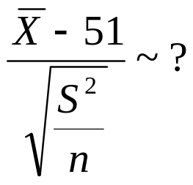
The checklist
Stap | information | example
1 | The hypotheses (the qualifying problem)
2 | The distribution in the population & σ²
3 | sample size
4 | The distribution of the sample mean under H₀
5 | The level of significance
6 | The test statistic
7 | The distribution of the review greatness
8 | The critical point (or points)
One-sided test

Slide 37
R code
> xbar=50.8;s=sqrt(1.6);n=100;H0=51
> test.statgy=(xbar-H0)/(s/sqrt(n))
> test.statgy
[1] -1.581139
> crit.point1=qnorm(0.95,lower.tail=TRUE)#p=0.05 one tailed
> -crit.point1
[1] -1.644854

Slide 38
Example (case c)
two-tailed test

Slide 39

Example: two-tailed test
At a certain university one takes many years an intelligence-off normally distributed with mean score results yields 115 (115 = μ under H₀).
An administrator wants now for the new class to test the hypothesis that the mean is the same as in previous years.
He takes a sample of size 50, and: mean 118 and variance 98.
n
S²

Slide 40
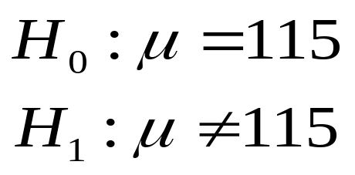
The testing problem
The choice of H₁ is to be determined by the consideration that the administrator has no idea whether the new crop is better or worse than the previous
Null hypothesis
Alternative hypothesis
two-tailed test

Slide 41
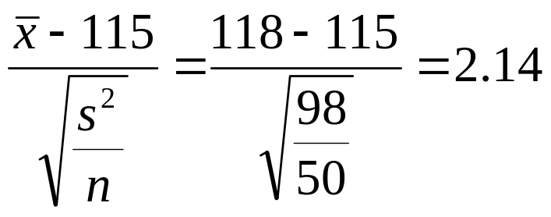


The rejection region (sided test)
The test statistic
2.14 > 1.96 the administrator rejects H₀ at significance level 0.05.
-1.96
1.96
2.14
rejection region
acceptance region
rejection region

Slide 42
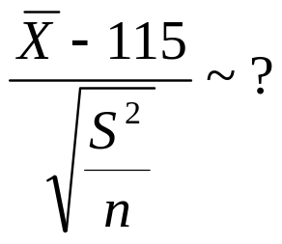
The checklist
Stap | information | Example
1 | The hypotheses (the testing problem)
2 | The distribution in the population& σ²
3 | sample size
4 | The distribution of the sample mean under H₀
5 | The level of significance
6 | The test statistic
7 | The distribution of the test statistic
8 | The critical point (or points)
One-sided test

Slide 43
R code
> xbar=118;s=sqrt(98);n=50;H0=115
> test.statcrop=(xbar-H0)/(s/sqrt(n))
> test.statcrop
[1] 2.142857
> alpha = 0.05
> crit.pointcrop = qnorm(1-alpha/2)
> crit.pointcrop
[1] 1.959964
> -crit.pointcrop
[1] -1.959964
> c(-crit.pointcrop,crit.pointcrop)
[1] -1.959964 1.959964

Slide 44
population, n & σ²
from above examples show that we are always three things to keep in mind:
which assumption we make about the distribution of the population?
is the variance σ² is known or should they be estimated using S²?
how big is the sample (which is the value of n)?

Slide 45
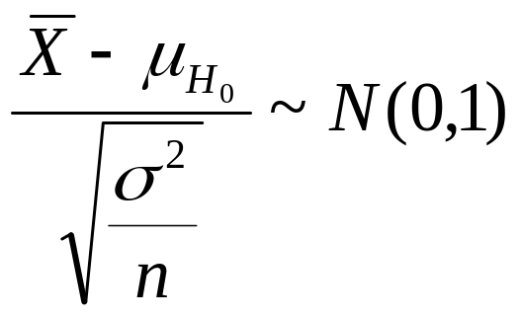
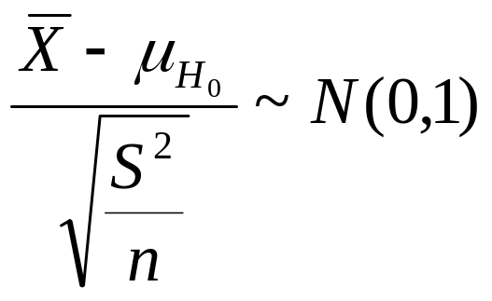
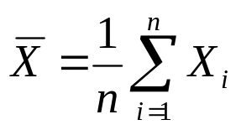
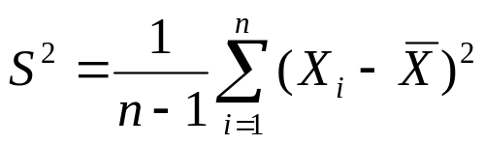
1: n large
For n large
If σ² is known
If σ² is unknown

Slide 46
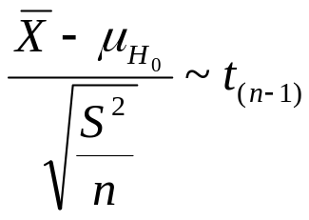
2: n small & normal distribution
2: n Small & normal distribution
If σ² is known
If σ² is unknown

Slide 47
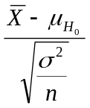

n | σ² | statistics | distribution of the population | Distribution for statistical
large | known |  | normal distribution or not known | Z(0,1)
large | not known |  | normal distribution or not known | Z(0,1)
small | known |  | normaal verdeling | Z(0,1)
small | not known |  | normal distribution | t(n-1)
small | not known |  | normal distribution | Not for this course

Slide 48
Part 7:
The P-value

Slide 49

The significance level and the critical point
In the examples on hypothesis testing, we have until now always pre specified significance level α (usually α = 0.05).
We determine the rejection region so:

Slide 50
The level of significance and the p-value
The relationship between the p-value and the level of significance is clear:
H₀ rejected on
significance level α if and only if
the p-value <α

Slide 51





Right-sided test
The distribution of the test statistic under H₀
observed value of
of
p-value

Slide 52





Example 1 (p-value): right-tailed test
population
sample
We look at student t distribution with 8 df
P-value = 0.1481026 > 0.05, we can not reject H₀.

Slide 53
R code
> x=c(22,19,17,26,21,20,29,27,22)
> xbar=mean(x)
> mu = 21
> s = sd(x)
> n = length(x)
> t = (xbar-mu)/(s/sqrt(n))
> alpha = .05
> pval = pt(t,df=n-1, lower.tail=FALSE)
> pval
[1] 0.1369174
P value

Slide 54





Left-sided test
The p-value
observed value of
of

Slide 55


Example 2 (p-value): left-tailed test
for each significance level > 0.0571 H₀ will be rejected

Slide 56
R code
> xbar=50.8;s=sqrt(1.6);n=100;H0=51
> test.statgy=(xbar-H0)/(s/sqrt(n))
> test.statgy
[1] -1.581139
> pval1 = pt(test.statgy,df=n-1,
+ lower.tail=TRUE)
> pval1
[1] 0.05851802

Slide 57


two-tailed test
observed value of
of

Slide 58

Example 3 (p-value)
for each significance level> 0.0324 H₀ will be rejected

Slide 59
R code
> bar=118;s=sqrt(98);n=50;H0=115
> test.statcrop=(xbar-H0)/(s/sqrt(n))
> test.statcrop
[1] 2.142857
> 2*(1-pnorm(test.statcrop))
[1] 0.03212457

Slide 60
The level of significance and the p-value
Statistical computer packages give as output a hypothesis test the p-value.
A generally accepted criterion (e. g in scientific publications) is as follows
If the P-value <0.05, then H0 is rejected, and then the results are significant.
if the p-value> 0.05, then H0 is not rejected, and then the results are not significant.

Slide 61
Hypotheses tests and Confidence intervals for two populations
Section 5.2: two sample test for paired data
Section 5.3: two sample test for independent data

Slide 62
Objectives
To distinguish between a problem associated with measurements and a two-sample problem using example.
To perform a test of hypothesis about the difference of two population means and two population proportions.
To calculate a confidence interval for the difference of two population means and the difference of two population proportions.
The tests and confidence intervals can perform and interpret using R.

Slide 63
Section 5.1 Section 5.2
Section 5.1
Section 5.2
population
population
sample
sample
One measurement per individual
Two measurements per individual

Slide 64
Section 5.1 Section 5.3
Section 5.1
Section 5.3
Twee populaties
population
Population 1
population 2
sample
sample 1
sample 2
Two independent samples

Slide 65
Two-samples test for paired data
Section 5.2

Slide 66


Paired measurements
Paired measurements: two surveys done (same characteristic) per individual.
Usually happen that two measurements with a certain interval.
The question then asked is: is there a difference between the two measurements?
population
Sample

Slide 67
Example 1: Paired measurements
10 women participating in a clinical trial.
We have two measurements of systolic blood pressure of 10 women: before and during treatment by hormone therapy.
The question of the researcher: is there a difference between the systolic blood pressure before and during treatment?

Slide 68




The data
systolic blood pressure
 | before | during
1 | 115 | 128
2 | 112 | 115
3 | 107 | 106
4 | 119 | 128
5 | 115 | 122
6 | 138 | 145
7 | 126 | 132
8 | 108 | 109
9 | 104 | 102
10 | 115 | 117
The average of the population before treatment: μ₁
The average of the population during the treatment: μ_{2.}

Slide 69


Solution
The null hypothesis: there is no difference between the systolic blood pressure before and during treatment
We can also write this as H₀
during
before

Slide 70

The difference (after - before)
We are interested in the difference of two means.
We have each woman associate number (the difference between the measurements)

Slide 71

The difference
The population average of the difference between the first measurement X and the second measurement Y is equal to:

Slide 72

The test hypothesis
Define: μ₂-μ₁ = μ_{D:}
Null hypothesis
Two sided test of hypothesis
Alternative hypothesis

Slide 73

Alternatieve hypothese
One sided
Two sided

Slide 74


Solution
We assume that the differences are normally distributed.
The sample size (n = 10) is small and σ² is not known.
Case 3
t test for a population

Slide 75




The test statistic
The sample :
The distribution of the test statistic under H₀ :
under H₀

Slide 76





The rejection region (1)
(Two-sided test)
We reject the null hypothesis if the value of is large or small
we reject the null hypothesis
c1
c2
rejection region
acceptance region
rejection region

Slide 77








The rejection region (2)
(Two-sided test)
For two-sided test problem
we reject the null hypothesis
-t
t

Slide 78


The rejection region
For significance level of 5% (and 9 degrees of freedom)
-t=-2.262
t=2.262

Slide 79




Decision
difference = systolic blood pressure during a treatment - systolic blood pressure before a treatment
We reject the null hypothesis at 5% significance level.

Slide 80
Test a difference between paired measurement using R
> Before<-c(115, 112, 107, 119, 115, 138, 126, 108, 104, 115)
> During<-c(128, 115, 106, 128, 122, 145, 132, 109, 102, 117)
> library(MASS)
> t.test(Before, During, paired=TRUE)
Paired t-test
data: Before and During
t = -3.0149, df = 9, p-value = 0.0146
alternative hypothesis: true difference in means is not equal to 0
95 percent confidence interval:
-7.876437 -1.123563
sample estimates:
mean of the differences
-4.5

Slide 81




The checklist
Step | Information | Example
1 | The hypotheses (the testing problem)
2 | Determine the Case
3 | The test statistic The distribution of the test statistic under the null hypothesis
4 | The level of significance
5 | The critical point (or points)
6 | Calculate the test statistic | -3.322
7 | The rejection region & Conclusion | Reject the null hypothesis
two-tailed test
σ² not known
-2.262 & 2.262 t(9)
two-tailed test

Slide 82

Notes
We can also test for
Null hypothese
Alternatieve hypothese
Where d is a specified number (not necessarily 0).

Slide 83


Confidence interval
It is also possible to give a confidence interval for the mean difference μ_{D}.
A 95% confidence interval for μ_{D}

Slide 84

Confidence interval
A 95% confidence interval for μ_{D}
[-7.876, -1.124]

Slide 85
Example 2
One sided test problem
A study on treatment against hunger.
A group of 9 people have medication hungry for two weeks.
During this period, record the people's hunger-score in a scale of 1 to 150 (1 = not hungry, 150 = very hungry).
After the treatment period, people have a break of two weeks without medication.
After two weeks, the men got a placebo for two weeks.
During the placebo period, scoring the people their hunger score.

Slide 86
Example 2
Break of two weeks
two weeks
two weeks
Treatment against hunger
Placebo
First measurement: hunger score under treatment
Second measurement: hunger score under placebo

Slide 87





Notation
hunger score under placebo
Two engineering methods for each individual
hunger score under treatment
&

Slide 88

The data (1)
hunger score
 | treatment | Placebo
1 | 79 | 78
2 | 48 | 54
3 | 52 | 142
4 | 15 | 25
5 | 61 | 101
6 | 107 | 99
7 | 77 | 94
8 | 54 | 107
9 | 5 | 64
drug
placebo

Slide 89



The data (2)

Slide 90



The testing problem
If the drug works, we expect that the hunger score under treatment will be lower than the hunger score under placebo.
One sided test problem
If the drug works, we expect

Slide 91





The distribution of the test statistic
n = 9 (small)
σ₁² and σ₂² unknown but equal
populations are normally distributed
We reject H₀ if:
Het verwerpingsgebied

Slide 92


The data
hunger score
 | Treatment | Placebo
1 | 79 | 78
2 | 48 | 54
3 | 52 | 142
4 | 15 | 25
5 | 61 | 101
6 | 107 | 99
7 | 77 | 94
8 | 54 | 107
9 | 5 | 64
the test statistic

Slide 93



The critical point in the table of Student t-distribution
we reject H₀

Slide 94
Test a difference between paired measurement using R
> placebo <-c(78, 54, 142, 25, 101, 99, 94, 107, 64)
> treatment <-c(79, 48, 52, 15, 61, 107, 77, 54, 5)
> library(MASS)
> t.test(treatment, placebo, paired=TRUE)
Paired t-test
data: treatment and placebo
t = -2.7014, df = 8, p-value = 0.02701
alternative hypothesis: true difference in means is not equal to 0
95 percent confidence interval:
-54.784709 -4.326402
sample estimates:
mean of the differences
-29.55556
In the R code: a two-sided test !!!

Slide 95



The checklist
Step | Information | Example
1 | The hypotheses (the qualifying problem)
2 | Detarmine the case
3 | The test statistic The distribution of the test statistic under the null hypothesis
4 | The level of significance
5 | The critical point (or points)
6 | Calculate the test statistic | -2.7014
7 | Conclusion | Reject the null hypothsis
One - sided key
σ² not known
-1.86 t(8)

Slide 96
Example: the sleep data
Data which show the effect of two soporific drugs (increase in hours of sleep compared to control) on 10 patients.
For each patient: data before and after the treatment.
Response: increase hours in sleep before and after the treatment.
Research question: does the treatment increase the sleeping hours ?
More about the data: use help(sleep) in R.

Slide 97

The sleep data: before - after
> before<-sleep$extra[sleep$group == 1]
> after<-sleep$extra[sleep$group == 2]
> diff<-before-after
> plot(c(1:10),diff)
> abline(0,0,col=2)
> mean(before)
[1] 0.75
> mean(after)
[1] 2.33
> mean(before)-mean(after)
[1] -1.58
before-after
subject

Slide 98
The hypothesis test
The null hypothesis: increase of sleeping hours in the
same before and after the treatment.
Two sided test of hypothsis

Slide 99
The sleep data: paired t test in R
> totes(before,after, paired = TRUE)
Paired t-test
data: before and after
t = -4.0621, df = 9, p-value = 0.002833
alternative hypothesis: true difference in means is not equal to 0
95 percent confidence interval:
-2.4598858 -0.7001142
sample estimates:
mean of the differences
-1.58
The C.I does not cover the value of zero.

Slide 100
Two sample test for independent data
Section 5.3

Slide 101




Two populations and two independent samples
Population 1
Population 2
we draw two samples independently
sample 1
Sample 2

Slide 102


we draw two samples independently
We're back interested in the difference between the two
averages μ₁ and μ₂ and set as nulhypothes
If the two populations is no difference in mean
Then (μ₂-μ₁)_{H0}=0

Slide 103

The sample means
The quantity that we get to test the hypothesis, initially from our samples will be as expected:
(the difference of the sample means)

Slide 104




The sample means

Slide 105



The distribution of the difference
For two independent samples

Slide 106


Case 1:
σ₁² and σ₂² known
Both populations are normally distributed.
σ₁² = σ₂²

Slide 107

Case 2: (two-sample t-test)
1. n₁ or n₂ small.
2. both populations are normally distributed.
3. σ₁² and σ₂² unnown but σ₁² = σ₂²
pooled sample variance

Slide 108


Case 3:
n₁ and n₂ large (>30).
the populations are not normally distributed.
σ₁² and σ₂² are known ( ).

Slide 109



Case 4a:
n₁ and n₂ large (>30).
the populations are not normally distributed.
σ₁² and σ₂² are not known

Slide 110


Situatie 4b:
n₁ and n₂ large (>30).
the populations are not normally distributed
2. σ₁² and σ₂² are not unknown
pooled sample variance

Slide 111
Example 3
One sided test problem
When an experiment is compared to the results of two treatments, A and B.
Treatment A was applied to a group of 6 randomly selected animals and treatment B in a group of 5 randomly selected animals.
The results were:
A | 17,19,15,18,21,18
B | 18,15,13,16,13
Here: n₁=6 and n₂=5.

Slide 112
The testing problem
The researcher claims that treatment A better average results than treatment B.
The average treatment A is greater than the average of treatment B (which type of test is this?)
We assume that both populations are normally distributed and the same variance.

Slide 113



The testing problem
The results of treatment A, and this is what we call X_{i}
treatment of B, Y_{i} .
We formulate the null and alternative hypothesis :
one sided test problem

Slide 114

Two independent samples
n₁ = 6 and n₂ = 5 (small)
σ₁² and σ₂² unknown but equal
populations are normally distributed
case 2:

Slide 115



The rejection region
We reject the null hypothesis
if
H₁ ⇒ one sided hypothesis, Significance level = 0.05, Critical point from the t-distribution table: t = -1.833
0.05
t
0
R.R
Not R.R

Slide 116



Solution: the sample mean and variance
pooled sample variance

Slide 117

Two independent samples
0.05
-1.833
0
R.R
Not RR
Based on the sample results, we conclude that the average
treatment A better results than treatment B (at 5%significance level).

Slide 118
One sided test for two independent sample using R
> A <- c(17, 19, 15, 18, 21, 18)
> B <- c(18, 15, 13, 16, 13)
> library(MASS)
> t.test(B, A,var.equal=T, alternative="less")
Two Sample t-test
data: B and A
t = -2.4111, df = 9, p-value = 0.01959
alternative hypothesis: true difference in means is less than 0
95 percent confidence interval:
-Inf -0.7191565
sample estimates:
mean of x mean of y
15 18
A one sided test.

Slide 119





The checklist
Step | information | Example
1 | The Hypothesis test
2 | Determine the case Case 2
3 | The test statistic The distribution of the test statistic under the null hypothesis
4 | The level of significance
5 | The critical point (or points) & R.R
6 | Calculate the test statistic | -2.41
7 | Conclusion | Reject the null hypothesis
One-sided test
σ² unknown
-1.833 t(9)

Slide 120


Remark
Also here one can calculate a confidence interval for the difference between the population means.
A 95% confidence interval for the difference μ₂ - μ₁ from the example given by

Slide 121

Confidence interval
[-5,8,-0.19]

Slide 122

Example 4: number FACEBOOK friends
Two sided test problem
According FACEBOOK statistics, 23% of the population aged 18-24 in Belgium have a FACEBOOK account (2011).
The researcher would like to know how-many FACEBOOK friends, men and women in this age group.
http://www.socialbakers.com/facebook-statistics/belgium

Slide 123




Multiplying the FACEBOOK friends
A researcher wants the number of facebook friends male and female patients, aged 18 to 24 compared.
The researcher assumes that in this age, there is no difference between the number of men and women friends in facebook.
number of facebook friends for a woman
number of facebook friends for a man

Slide 124
Information on the population and sample
n₁ = 35 and n₂ = 40 (>30)
σ₁² and σ₂² unknown but equal
distribution of the population: not known
Case 4b:

Slide 125

The testing problem
We formulate the null and alternative hypothesis :
Under H0, in this age, there is no difference between the number of face book friends of men and women.

Slide 126


The sample
The researcher draws a sample of 35 men and 40 women in the age group 18-24.

Slide 127

The rejection region (two sided test)
The test statistic
-1.8354> -1.96 we can not reject H₀ at significance level 0.05.
-1.96
-1.8354
1.96
rejection region(R.R)
Acceptance region
rejection region(R.R)

Slide 128
The rejection region (for significance level of 10%)
-1.8354 < -1.645 we reject the null hypothesis at significance level 0.1.
-1.96
-1.8354
-1.645
-1.645
1.96
Acceptance Region
rejection region(R.R)
rejection region(R.R)

Slide 129





The checklist
Step | informatie | Example
1 | Test of Hypothesis
2 | Determine case
3 | The test statistic The distribution of the test statistic under the null hypothesis
4 | The level of significance
5 | The critical point (or points) & R.R
6 | Calculate the test statistic | -1.8354
7 | Conclusion | Do not reject at 5% level of significance
Two sided test problem
σ₁² and σ₂² are unknown
-1.96 & 1.96 N(0,1)

Slide 130
Example: chicken weights by feed type
An experiment was conducted to measure and compare the effectiveness of various feed supplements on the growth rate of chickens.
Newly hatched chicks were randomly allocated into six groups, and each group was given a different feed supplement.
Their weights in grams after six weeks are given along with feed types.

Slide 131
Example: chicken weights by feed type
Main interest: the weight of two feed supplements groups: horsebean & linseed.
Research question: does the feed type (horsebean or linseed) influence the chick weight ?

Slide 132

Example: Chicken weights by feed type
> x<-chickwts$weight[chickwts$feed=="horsebean"]
> y<-chickwts$weight[chickwts$feed=="linseed"]
> mean(x)
[1] 160.2
> mean(y)
[1] 218.75
> boxplot(x,y)
horsebean
linseed

Slide 133
The testing problem
We formulate the null and alternative hypothesis :
Under H0, there is no difference between the chicks’ weight under the two diets.
The population mean of the horsebean feed
The population mean of the linseed feed

Slide 134
Example: Chicken weights by feed type
> x<-chickwts$weight[chickwts$feed=="horsebean"]
> y<-chickwts$weight[chickwts$feed=="linseed"]
> mean(x)
[1] 160.2
> mean(y)
[1] 218.75
> boxplot(x,y)
horsebean
linseed

Slide 135
Chicken weights by feed type: two sample test for independent data in R
> t.test(y,x,var.equal = TRUE)
Two Sample t-test
data: y and x
t = 2.934, df = 20, p-value = 0.008205
alternative hypothesis: true difference in means is not equal to 0
95 percent confidence interval:
16.92382 100.17618
sample estimates:
mean of x mean of y
218.75 160.20

